Slide 1
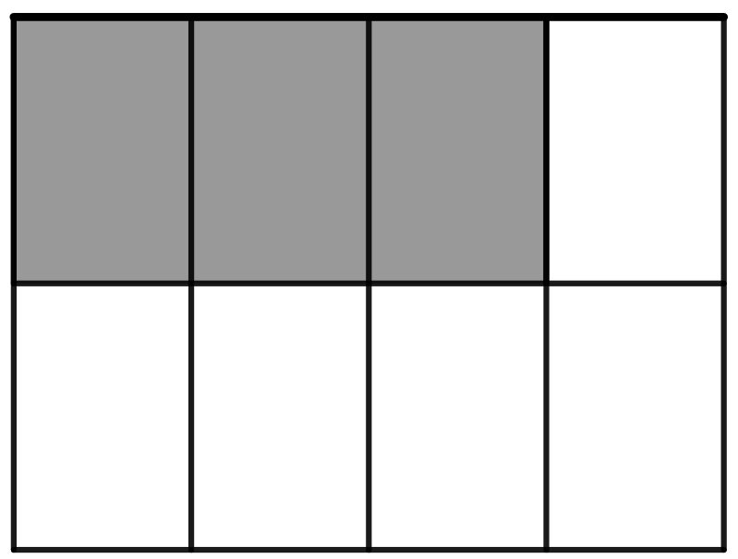
Part-whole item
What fraction of the whole rectangle is shaded?

Slide 2
What fraction of the smiley faces below are shaded?

Slide 3
2/5 of the smiley faces are shaded.
About 70% of students are expected to get this item right.

Slide 4
Quotient item
Three friends are sharing two chocolate bars. How could they split
the bars so that each friend gets the same amount of chocolate?
How many bars worth of chocolate does each friend get?

Slide 5
Quotient solution
The friends can split each bar into three equal pieces. Each friend gets 2/3 of a bar.
About 49% of students are expected to get this item right.

Slide 6
Mark where ¾ is on the number line below.
0
¼

Slide 7
0
¼
¾
About 22% of students are expected to get this item right.

Slide 8
Jamie usually makes punch by mixing 2 cups of orange juice with
3 cups of pineapple juice. This time, she wants it to have a stronger orange flavor. Which of the following ratios of orange juice to
pineapple juice could she use?
A) 4:6 B) 2:4 C) 4:3

Slide 9
Each friend got (¼)/3 = 1/12 of the cake.
About 15% of students are expected to get this item right.

Slide 10
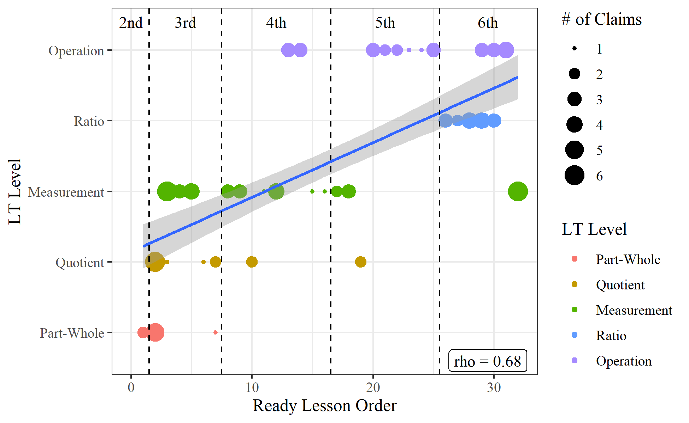

Slide 11
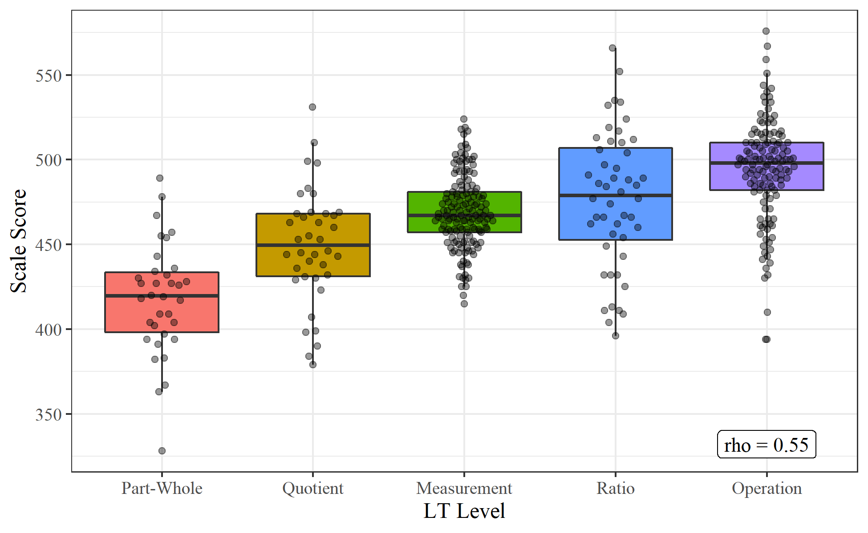

Slide 12
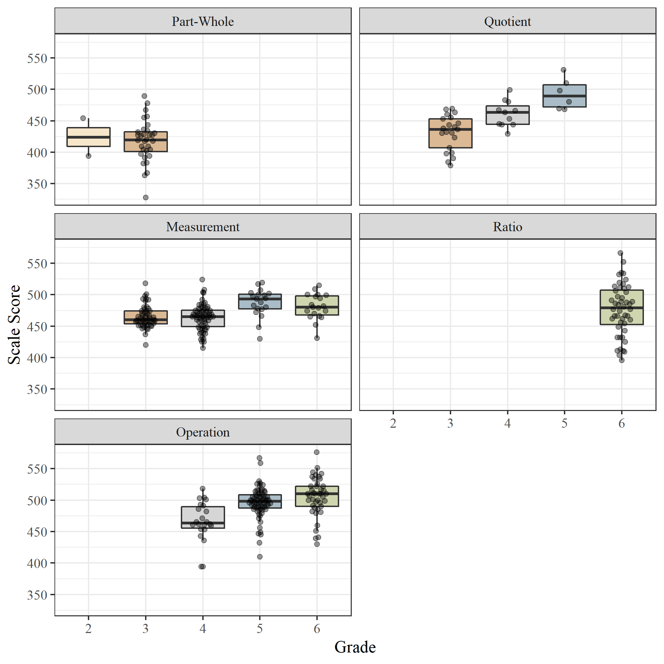

Slide 13
Prompt: Split eight counters evenly between four people.
Incorrect Number of Groups
Unequal Groups
Not Exhausting the Set

